Slide 1

The Drive By Project
Software Manager: Dirk Thieme
Hardware Manager: Erik Manis
Project Controller: Mohammed Ansari

Slide 2
The Project Description & Objectives
Using a BASYS board, H bridge board and sensors to make a rover move along a metallic path and identify friendlies and hostiles along its path while also shooting the enemies by firing rubber bands at them

Slide 3
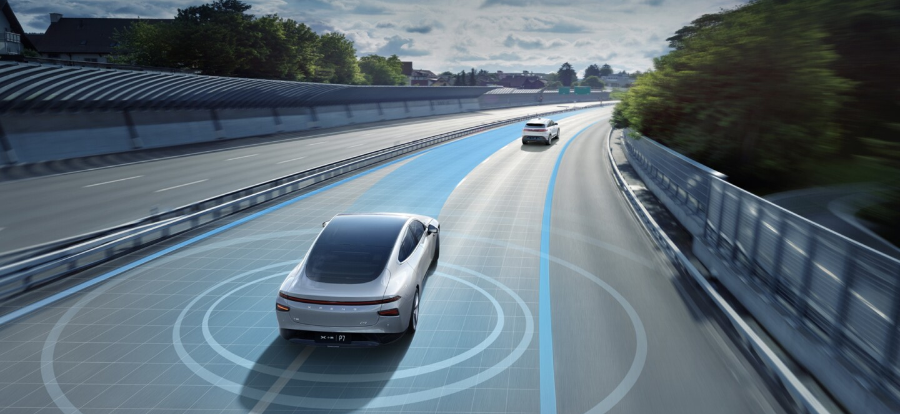
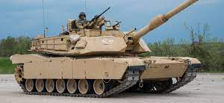
Project Opportunity
Military use : The rover’s capability could be enhanced to rival that of a military tank by improving the armor and the weapon placed on top of it
Self driving : The rover’s IR sensor could be replaced with other sensors that could track the path a self driving car would have to go on. The phototransistors could also be replaced with something that would detect other stuff that is close to the vehicle

Slide 4
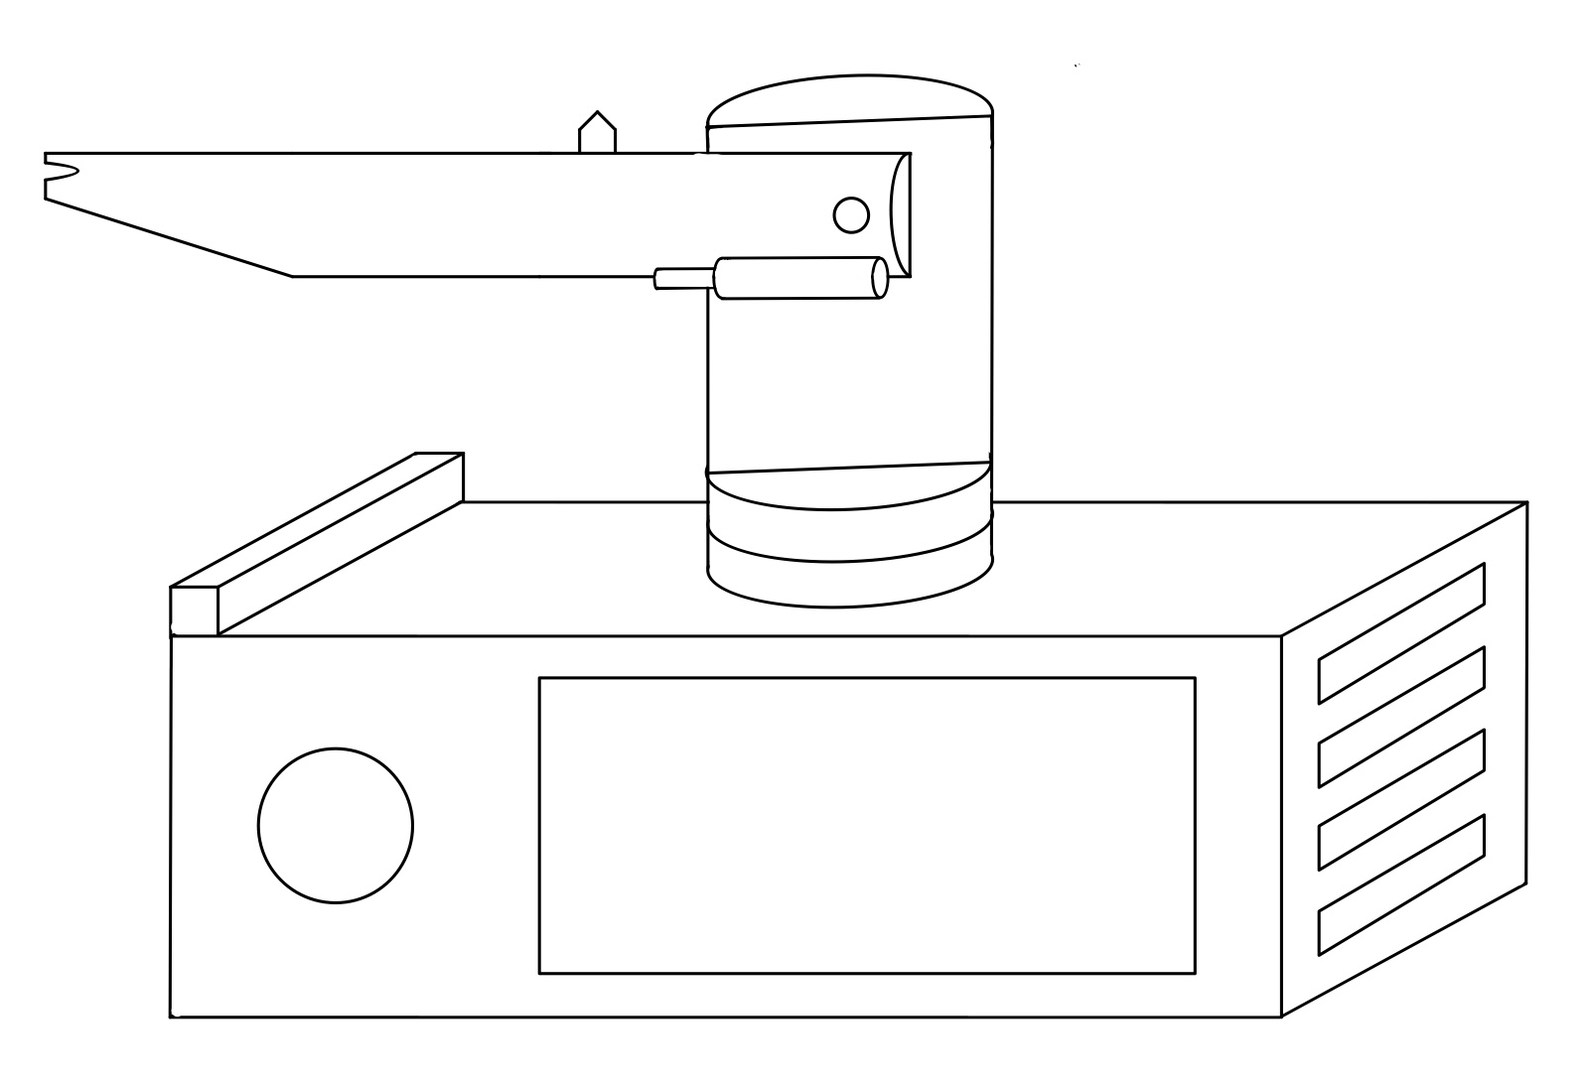
Project Sketch

Slide 5
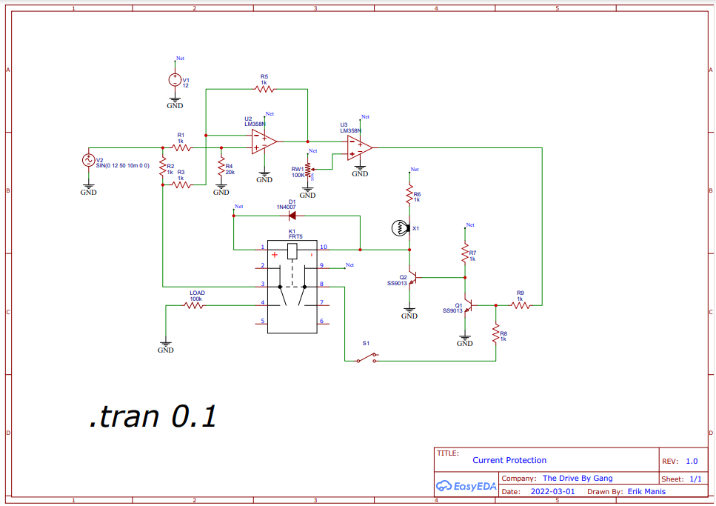
Hardware

Slide 6
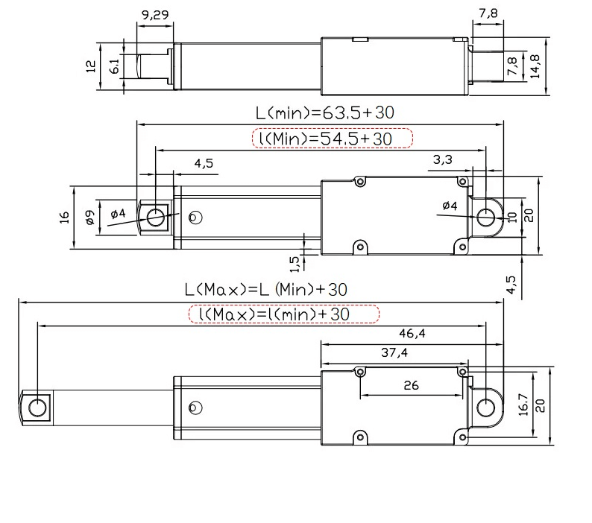
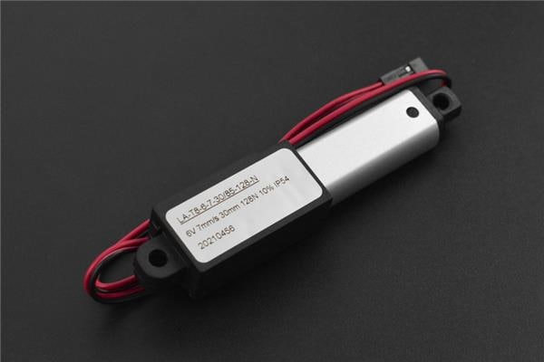
Hardware
6V Actuator

Slide 7
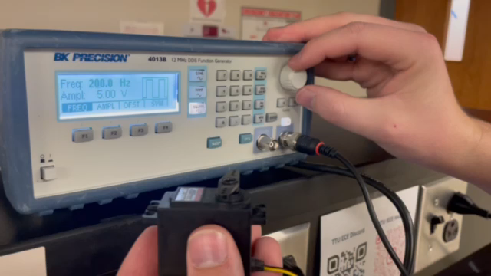
Hardware
Servo Testing

Slide 8
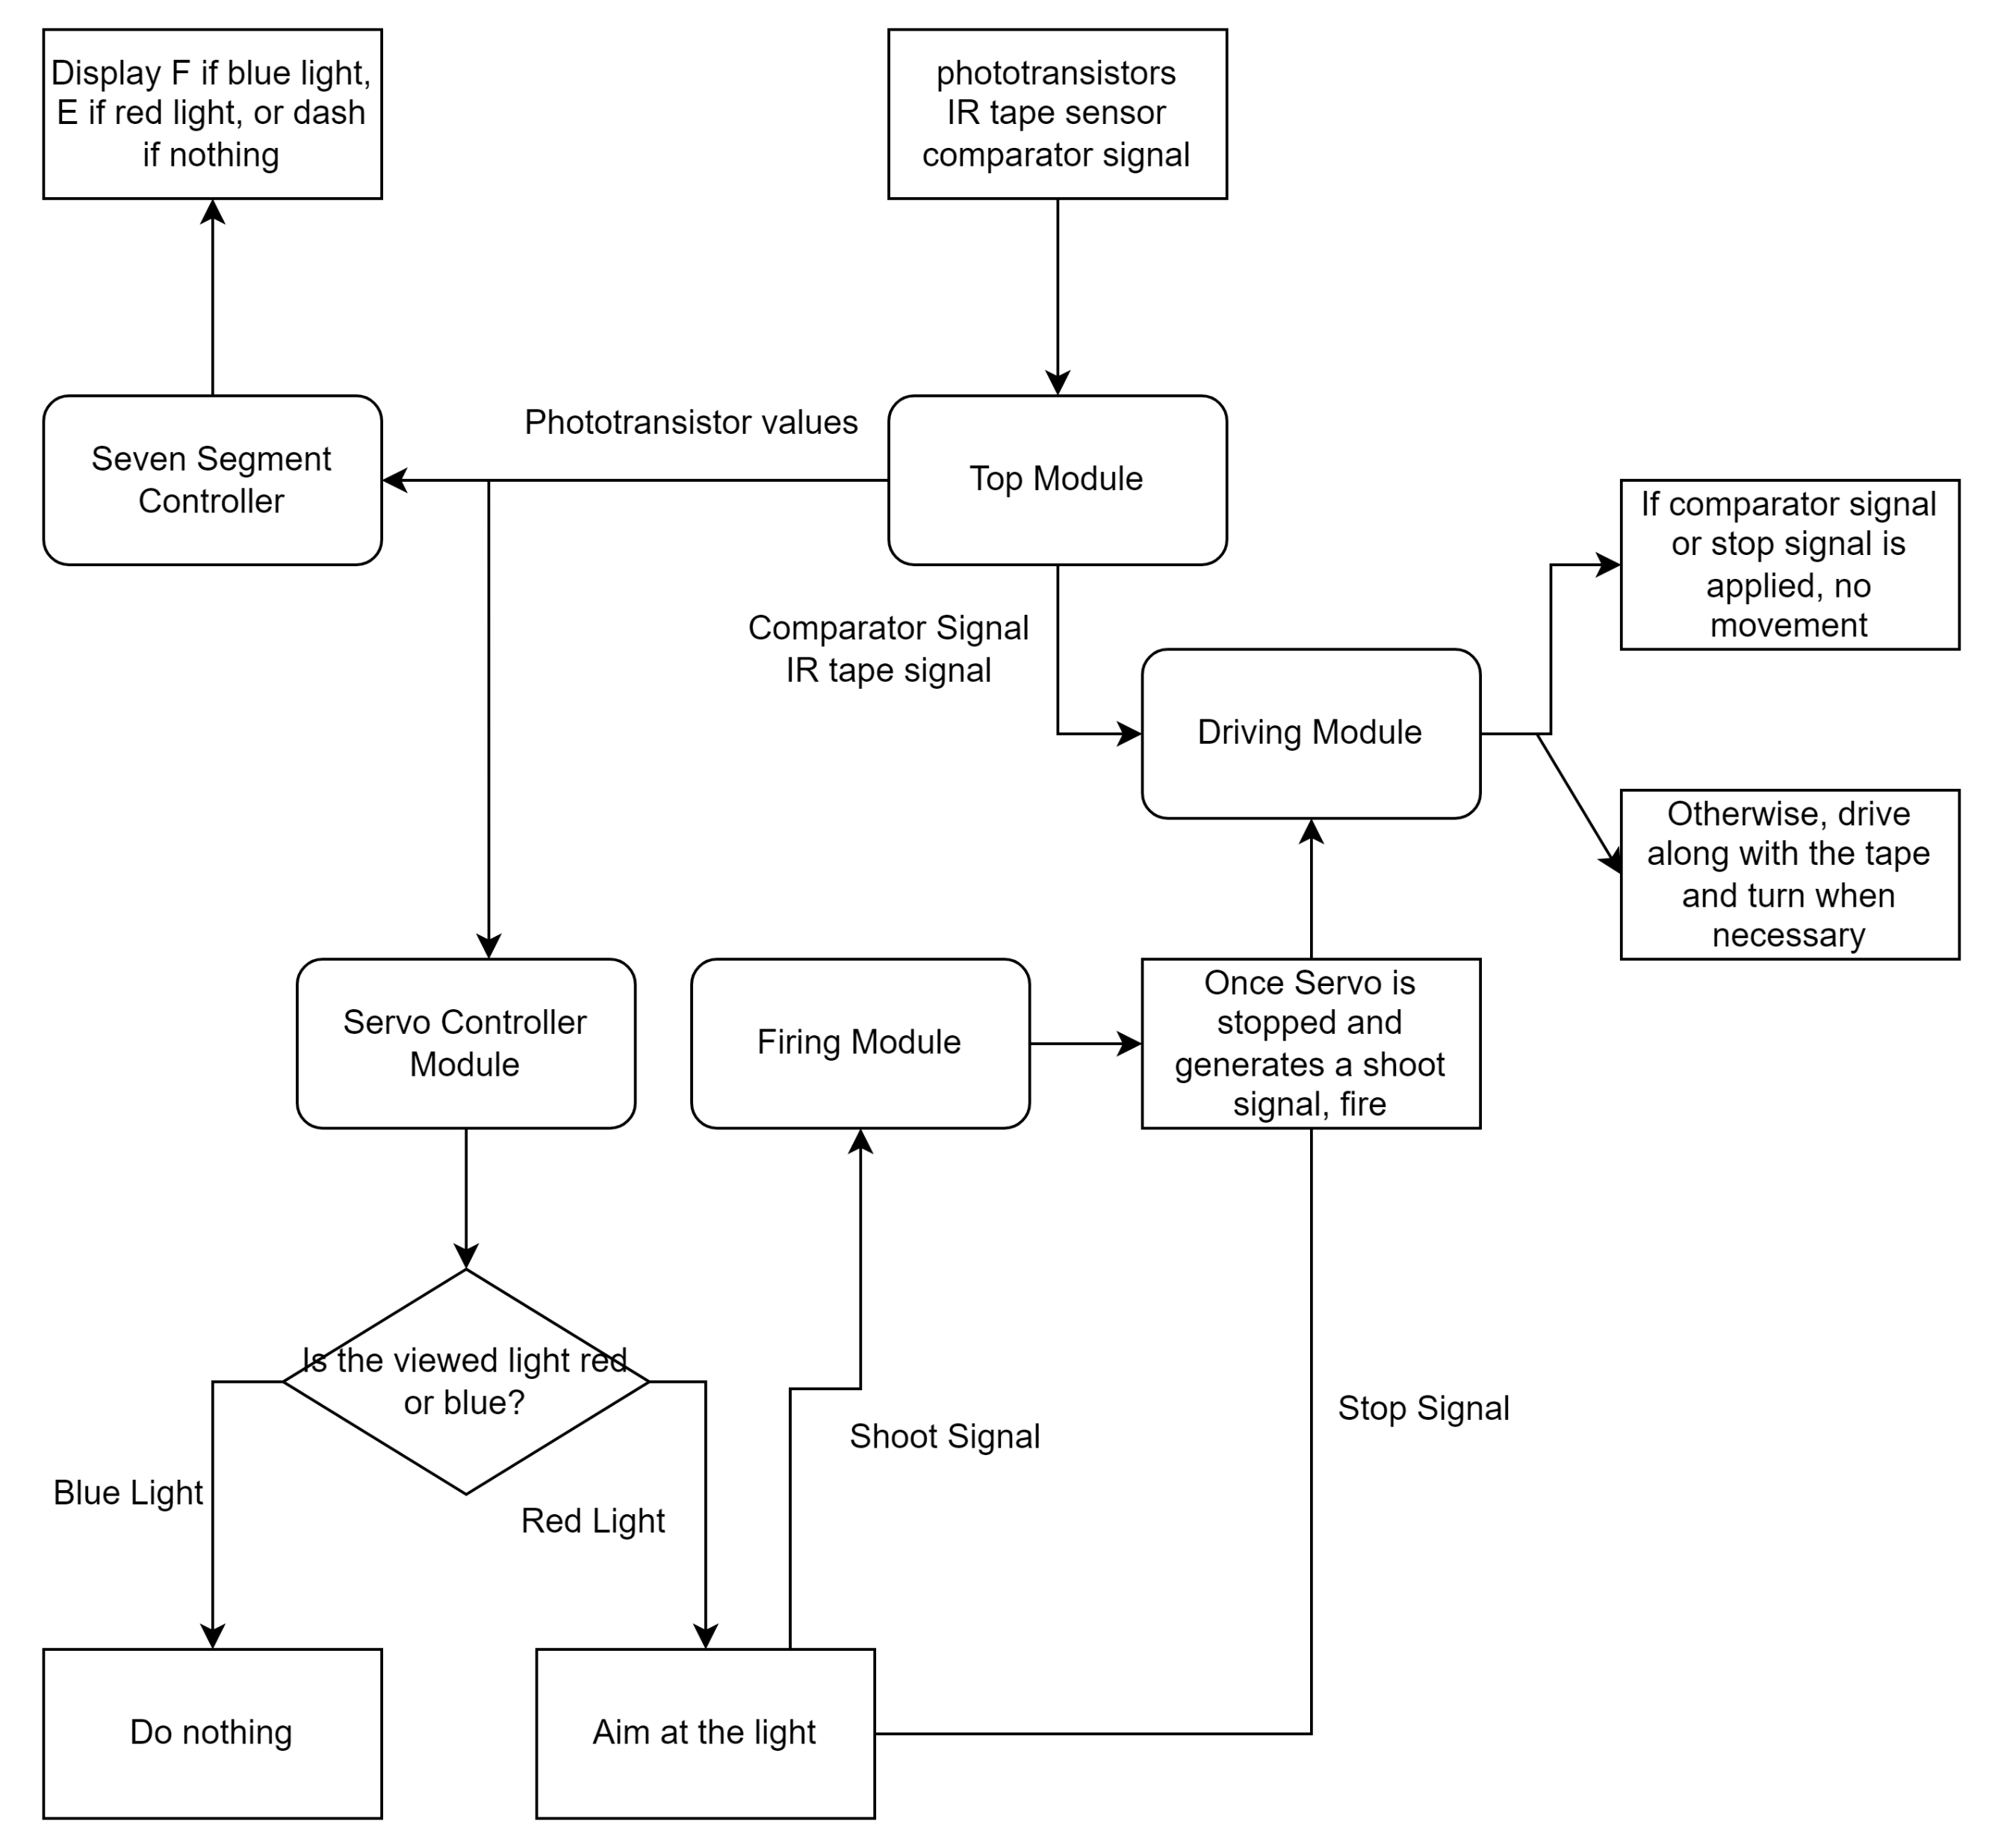
Software

Slide 9
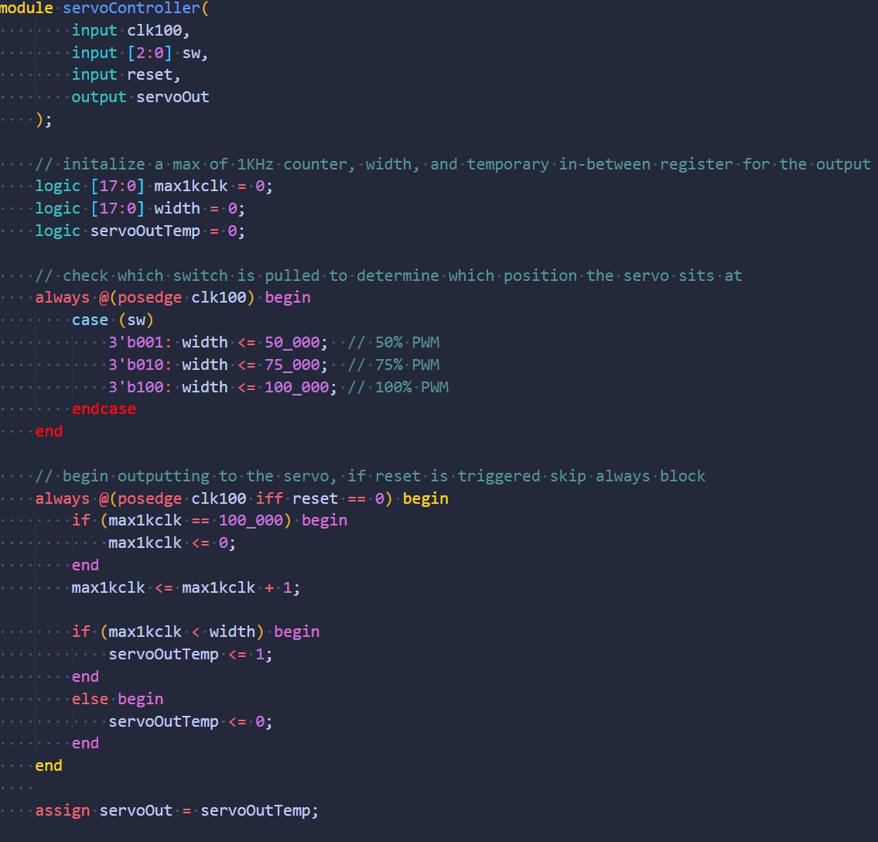
Software
Servo Controller

Slide 10
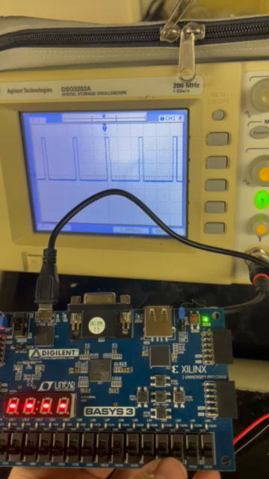
Software
Servo Test

Slide 11
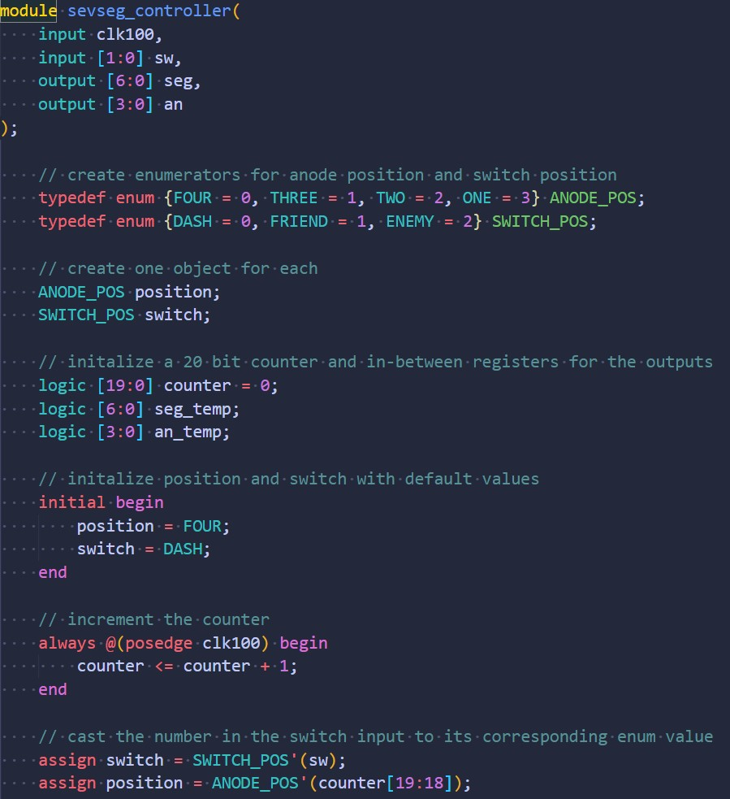
Software
Seven Segment Display pt. 1

Slide 12
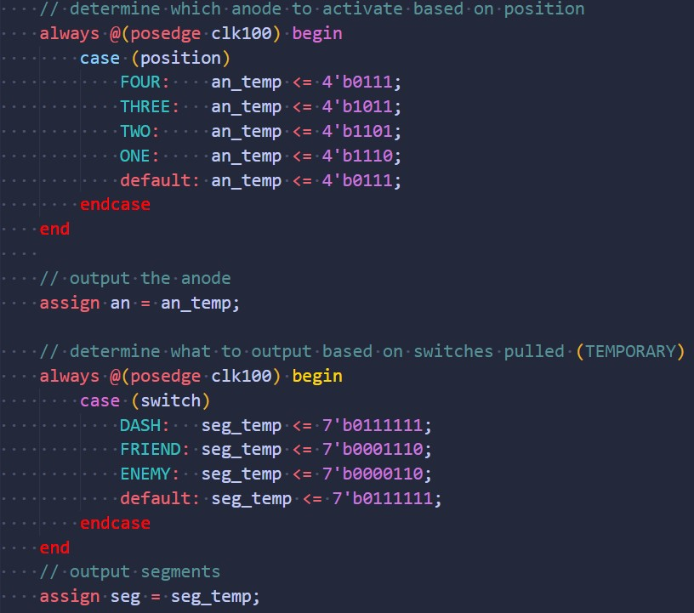
Software
Seven Segment Display pt. 2

Slide 13
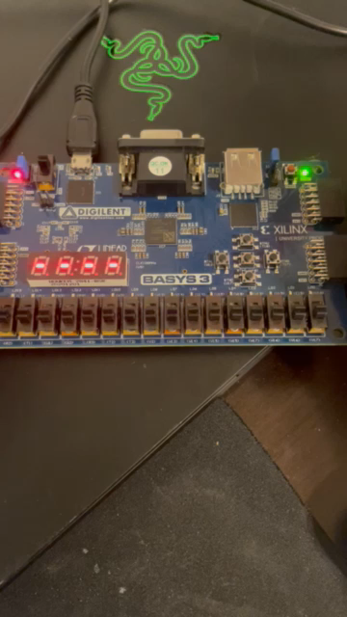
Software
Seven Segment Test

Slide 14
Gantt

Slide 15
Overall Budget

Slide 16
Labor Hours and Material costs

Slide 17

Questions
Software Manager: Dirk Thieme
Hardware Manager: Erik Manis
Project Controller: Mohammed Ansari
This Photo by Unknown author is licensed under CC BY.

